Slide 1
Lead Score Case Study
Collaborators
Soundari Govindan
Kunal Garg
Jeena Elizabeth Jose

Slide 2
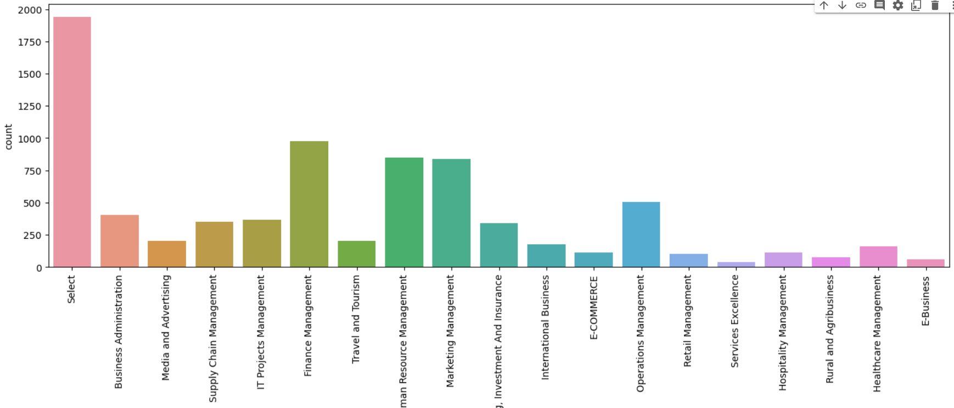
Problem Statement
An education company- X Education is looking for potential customers who would use its Education platform for upskilling. The company notes the leads – leads are the ones who shows an interest to join the different courses. X Education requires to build a model where in ,we need to assign a lead score to each of the leads. Customers with higher lead score have a higher conversion chance and the customers with lower lead score have a lower conversion chance. In order to get a better lead conversion rate, the company needs to identify the ‘hot leads’. Hot Leads are the most potential leads who will eventually be the customers.

Slide 3
Analysis - Flow
Step 1.Importing the Data Step 2.Inspecting the Data Step 3.Data Cleaning and Preparation 3.1 Exploratory Data Analysis 3.2 Checking Outliers Step 4. Test – Train Split Step 5.Feature Selection Step 6.Model Building Step 7.Plotting the ROC Curve Step 8.Finding Optimal cut off Step 9. Prediction making

Slide 4
Test – Train Split
Target Variable (y) – Converted
Independent Variables (X) – Total 74 variable
Splitting Train Data – 60 %
Split of Test Data – 40 %
Assume Random State – 100
Feature Scaling – Minmax Scaler

Slide 5
● Feature Selection – RFE a logistic regression model was built in Python using the function GLM() under statsmodel library. ● Some variables were removed first based on an automated approach, i.e. RFE (Running RFE with 20 variables) ● Manual approach based on the VIFs and p-values are used for further process. ● After dropping some columns which has p-values above 0.05 and very high VIF we have obtained our final model with 14 variables.
Model Building

Slide 6
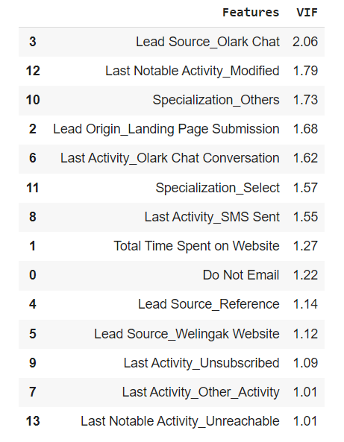
Features of final model

Slide 7
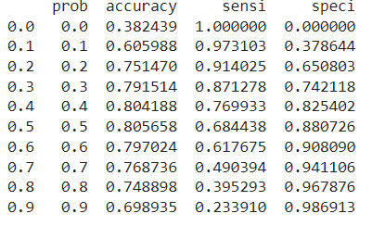
Metrics for Probability Cut Off

Slide 8
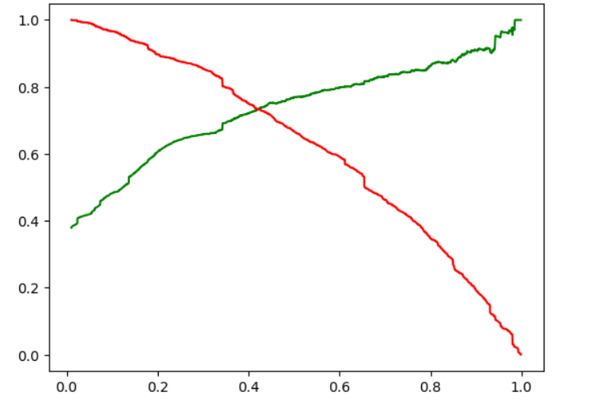
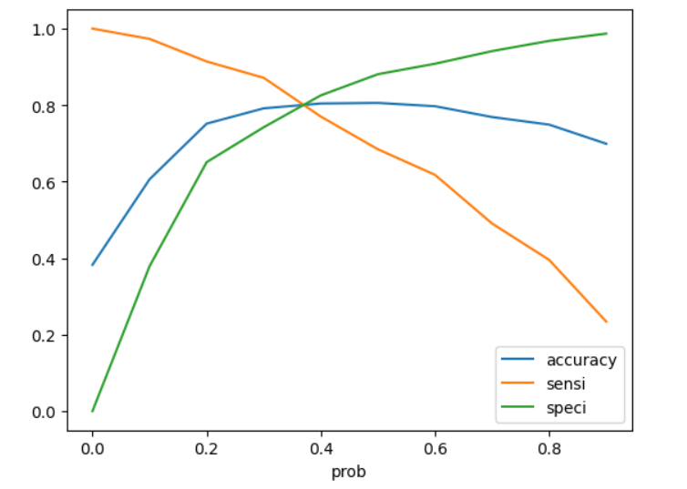
Finding optimal cut off
Optimal cut off was arrived using Sensitivity, Specificity, Accuracy and precision and recall Trade-off .
● The optimum point to take it as a cut off probability is 0.38
Fig 1. Precision Recall Trade off curve
Fig 1. Cut off taking accuracy, sensitivity and specificity

Slide 9
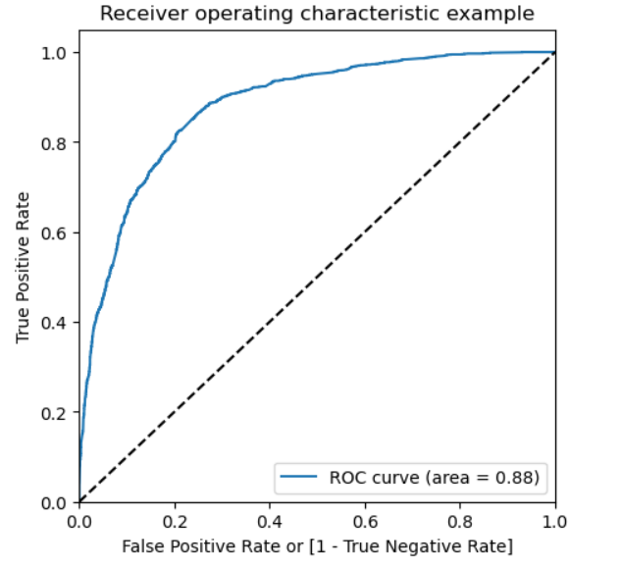
ROC Curve
ROC Curve indicates the trade off between sensitivity and specificity.
The closer the curve follows the left-hand border and top border of the ROC space, the more accurate the
test.
● ROC Curve area is 0.88, which is good.

Slide 10
Making predictions on the Test Data
A cut-off point of .38 is chosen based on the precision and recall tradeoff curve.
● Based on the predictions on the test dataset we have obtained the values for Sensitivity (77.67%),Specificity
(80.72% )
Results
Trained Data | Test Data
Accuracy – 79.57 % | Accuracy – 79.58 %
Sensitivity – 85.06 % | Sensitivity – 77.67 %
Specificity – 76.17 % | Specificity – 80.72 %
Precision – 78.03 % | Precision – 70.53 %
Recall – 68.44 % | Recall – 77.67 %

Slide 11
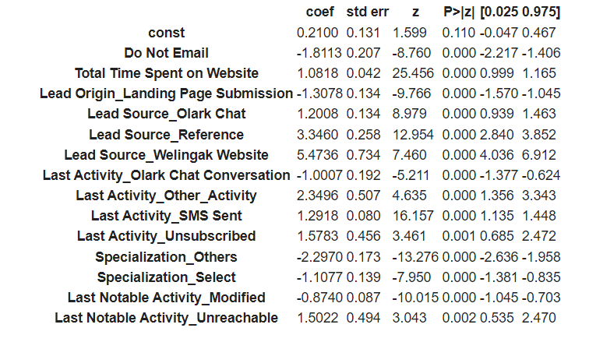
Final Model

Slide 12
Conclusion
Company should focus more on the below features to get a lead converted.
Last Activity
Lead Source
Total Time spent on the website
As we see, Lead Source_Welingak Website and reference has the highest positive impact on the lead conversion, company should focus more on the referral leads during the aggressive calling phase.

